Slide 1


The Importance of Philosophy of Science in Science Education v.2
Intern: Eyan Weissbluth
Mentor: Dr. Tuna Yildirim
Funded through the NASA Space Grant Program

Slide 2
Overview
Philosophy of Science and its Modern Importance
Previous Incarnations
Present Survey
Results

Slide 3
Philosophy of Science as a field
Begins with the Greek study of Natural Philosophy
Enlightenment opens up wellspring of new ideas
Advancements in empirical evidence and scientific communities begin forming in 20th century

Slide 4
Why Does This Matter Today
Past scientific communities have dealt with similar issues that come up today:
How do we formalize research methods?
What does it mean to have empirical knowledge?
Is it possible to “know” what science is? If so, how do we teach it?

Slide 5
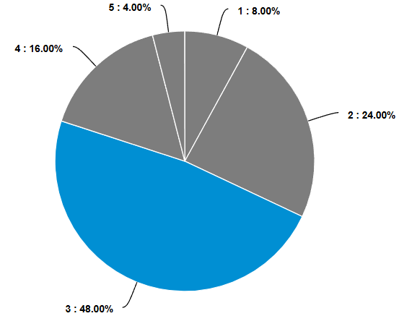
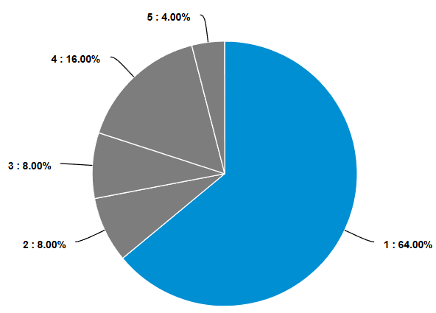
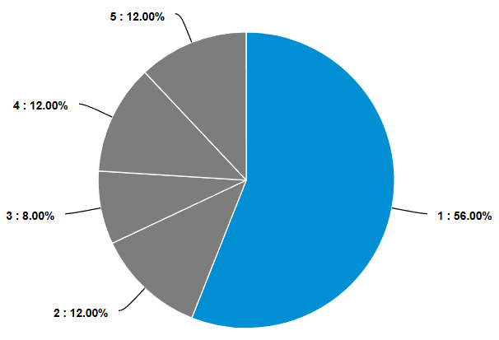
Past Survey
Demonstrated a lack of PoS knowledge
Unable to determined specific gaps
Left us wanting to know what historical ideas are researchers are engaging with
How would you rate your knowledge of philosophy of science?
How would you rate your knowledge of Karl Popper's contributions to philosophy of science?
How would you rate your knowledge of Thomas Kuhn's contributions to philosophy of science?

Slide 6
More Specific Topics
Thomas Kuhn
Beginner = 1-25
Intermediate = 26-50
Expert = 51-75
Advanced = 76-100
How familiar are you with Kuhn’s concept of “normal science” as problem-solving within an accepted paradigm?
How familiar are you with Kuhn’s idea of paradigm shifts and scientific revolutions that change how scientists view their field?
How familiar are you with Kuhn’s claim that different paradigms can be incommensurable (not directly comparable)?
How familiar are you with critiques of Kuhn’s theory, such as whether it implies relativism or undermines scientific progress?
René Descartes
Beginner = 1-25
Intermediate = 26-74
Expert = 75-100
How familiar are you with Descartes’ use of methodical doubt as a foundation for certain knowledge?
How familiar are you with Descartes’ idea that knowledge should be built from clear and distinct principles?
How familiar are you with Descartes’ emphasis on deduction and rationalism influencing later scientific methods?

Slide 7
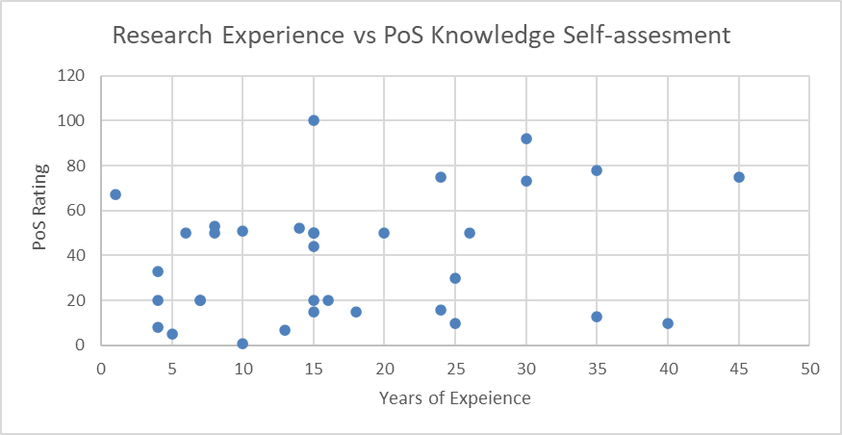
Results

Slide 8
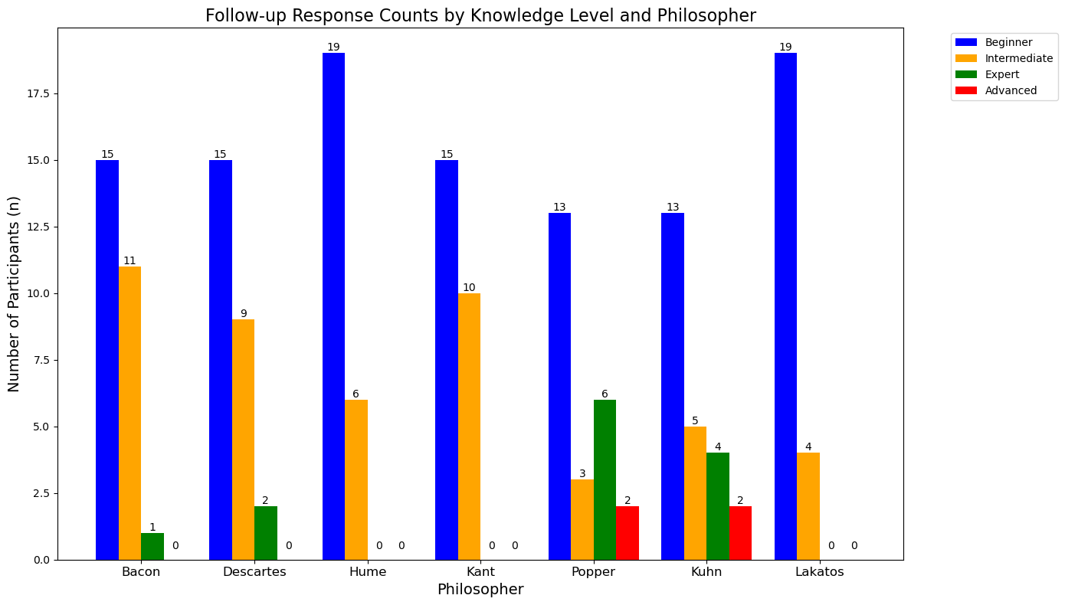
Results

Slide 9
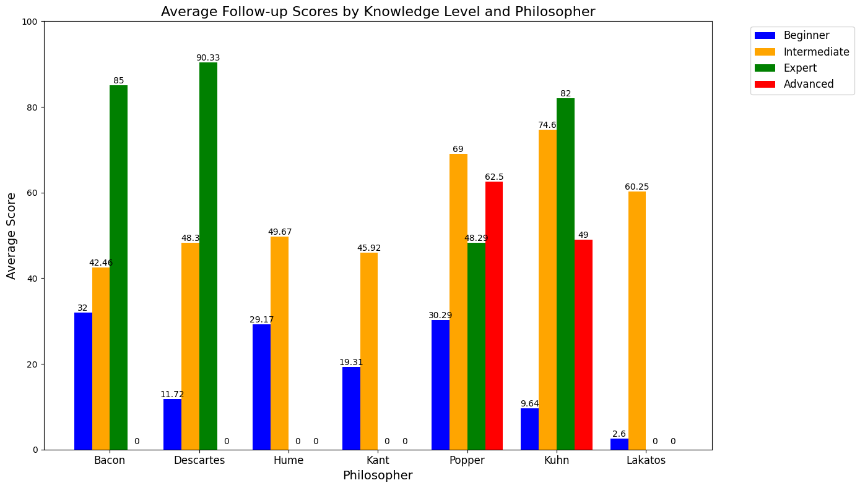
Results

Slide 10
What philosophical issues, if any, do you see in your field?
Why do people willfully ignore evidence and accept making emotional decisions even when they recognize that it is irrational, illogical, may result in harm to them or other individuals, etc.?
That substantial progress can be made absent empirical observations.
Is mathematics invented or discovered?
Nature of engineering knowledge hard to define.
Computation simulations with little connection to reality, but claiming to solve everything.
Discover the basic and fundamental causes of phenomena and the effective concept of truth in society.
Criteria for falsifiability of a theory - Reasons that certain research directions are unpopular (social bias vs. objective merits)
How should science properly interface with statistics to determine the truth or falsehood of statements?

Slide 11
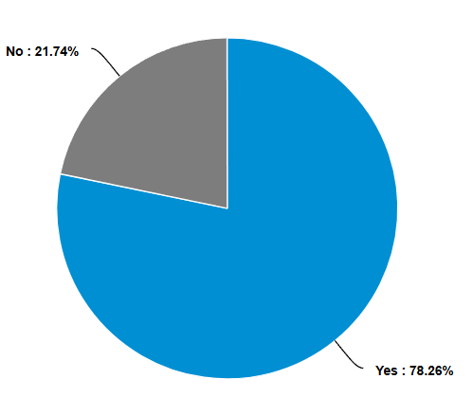
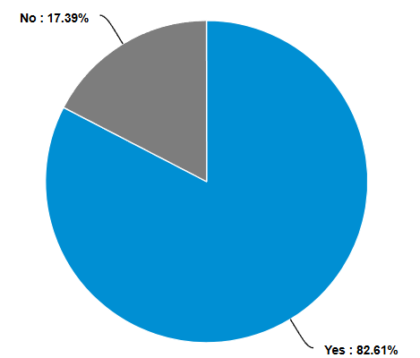
Do you think philosophy of science education is relevant to addressing the philosophical issues in your field?
Do you think every science student should take a dedicated philosophy of science class?

